Slide 1




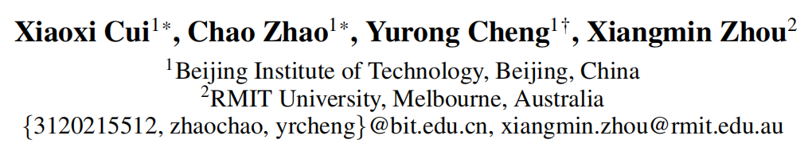





ATAI
Advanced Technique of Artificial Intelligence
ATAI
ChongqingUniversity _{AdvancedTechniqueof}
of Technology Artificial Intelligence
Chongqing University of Technology
Chongqing University ^{ATAI}
_{of Technology} Advanced Techniqueof
Artificial Intelligence
Chongqing University of Technology
Chongqing University of Technology
De-collapsing User Intent: Adaptive Diffusion Augmentation with
Mixture-of-Experts for Sequential Recommendation
—— AAAI ’26
Reported by Xin H.
1
Notes:
利用大语言模型弥补知识感知推荐中的用户侧知识差距

Slide 2
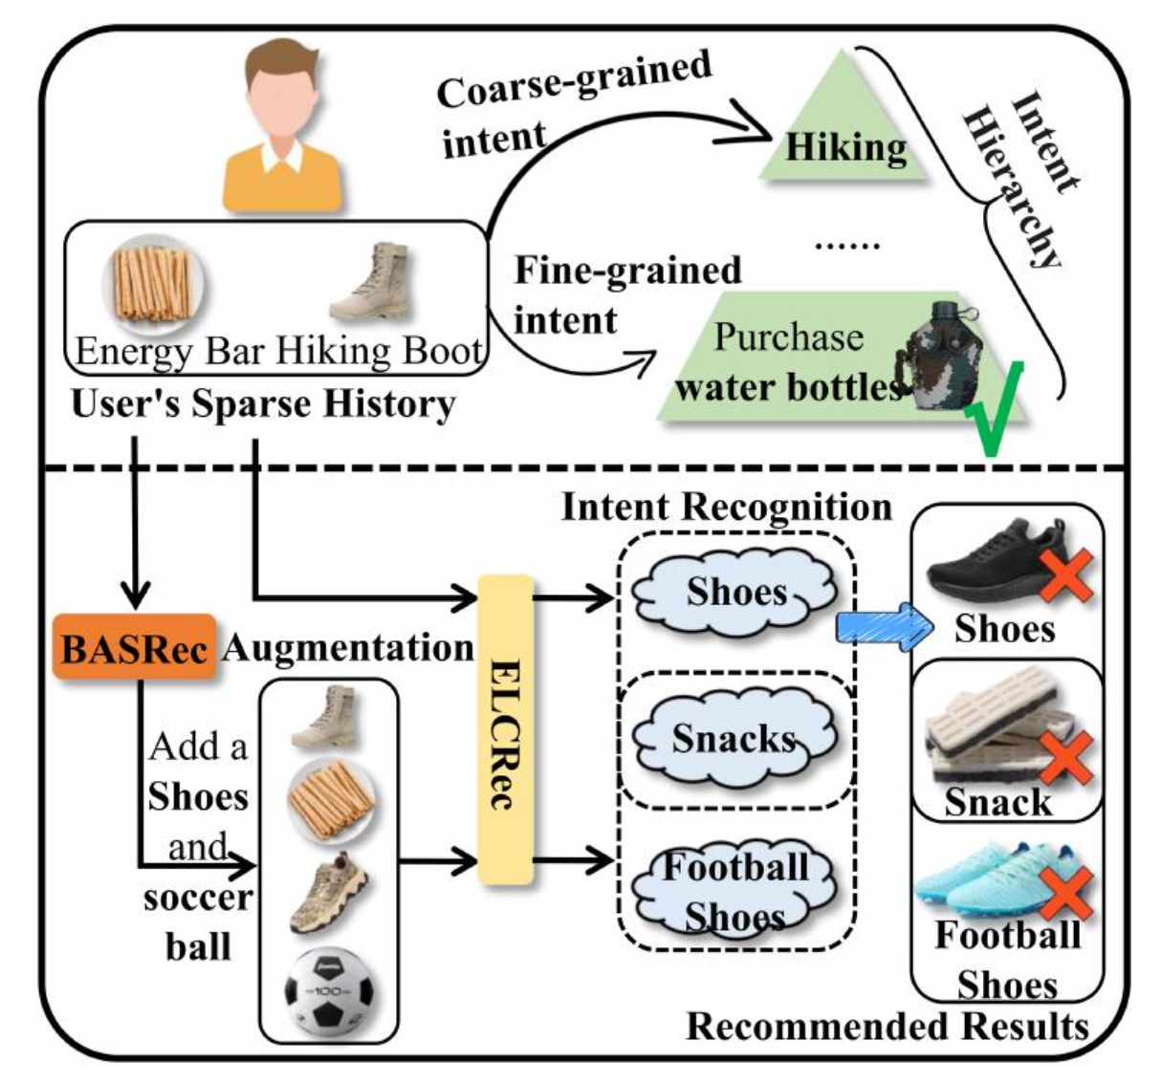
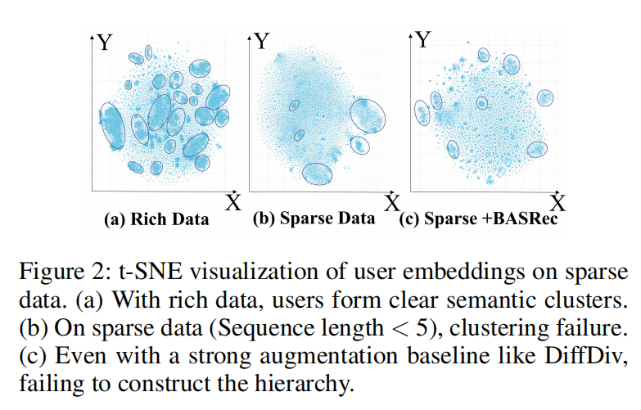
Motivation
ATAI
Advanced Technique of
Artificial Intelligence
ATAI
ChongqingUniversity _{AdvancedTechniqueof}
of Technology Artificial Intelligence
Chongqing University of Technology
数据稀疏性导致模型无法捕捉用户意图。
现有数据增强方法引入了意图无关的数据，导致模型误判用户意图。

Slide 3
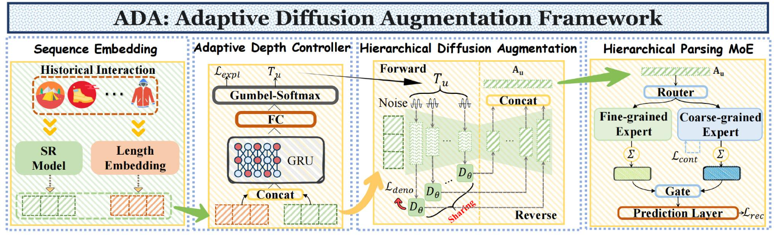
Overview
ATAI
Advanced Technique of
Artificial Intelligence
ATAI
ChongqingUniversity _{AdvancedTechniqueof}
of Technology Artificial Intelligence
Chongqing University of Technology

Slide 4
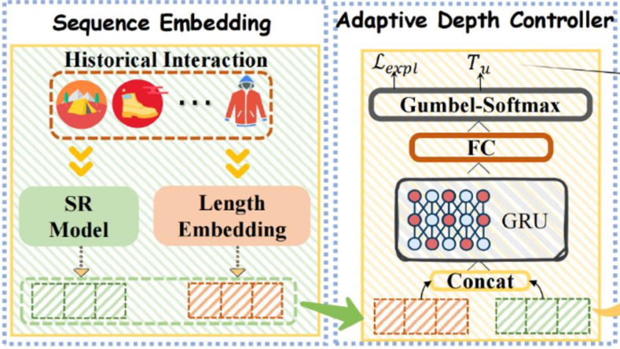

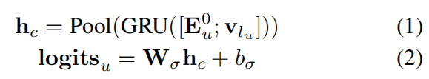

Method
ATAI
Advanced Technique of
Artificial Intelligence
ATAI
ChongqingUniversity _{AdvancedTechniqueof}
of Technology Artificial Intelligence
Chongqing University of Technology

Slide 5
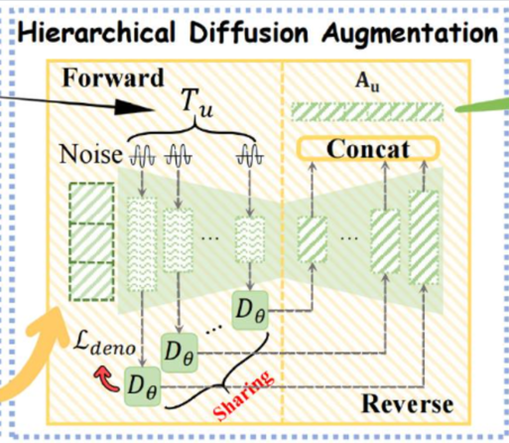
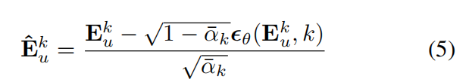

Method
ATAI
Advanced Technique of
Artificial Intelligence
ATAI
ChongqingUniversity _{AdvancedTechniqueof}
of Technology Artificial Intelligence
Chongqing University of Technology

Slide 6
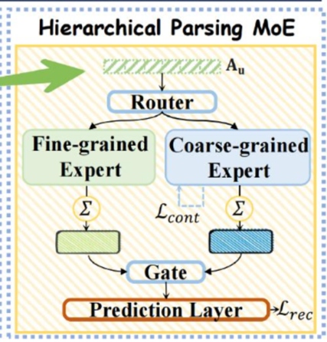
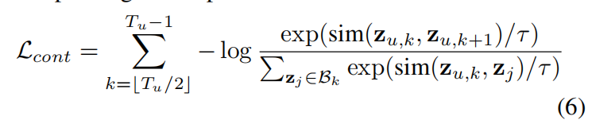
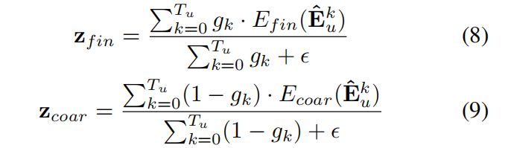
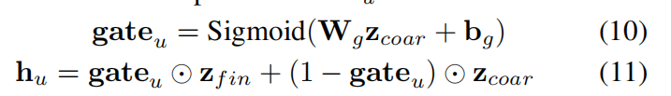
Method
ATAI
Advanced Technique of
Artificial Intelligence
ATAI
ChongqingUniversity _{AdvancedTechniqueof}
of Technology Artificial Intelligence
Chongqing University of Technology

Slide 7
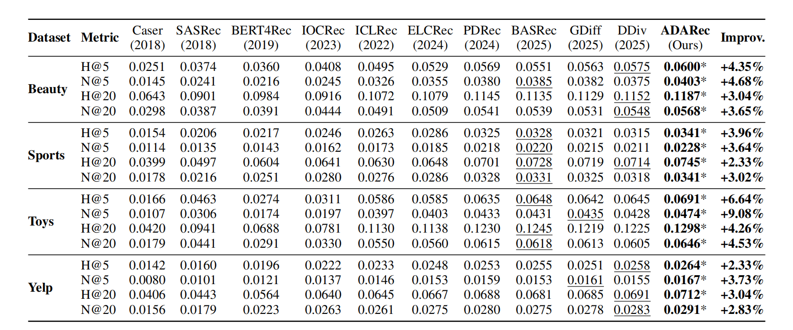
Experiments
ATAI
Advanced Technique of
Artificial Intelligence
ATAI
ChongqingUniversity _{AdvancedTechniqueof}
of Technology Artificial Intelligence
Chongqing University of Technology

Slide 8
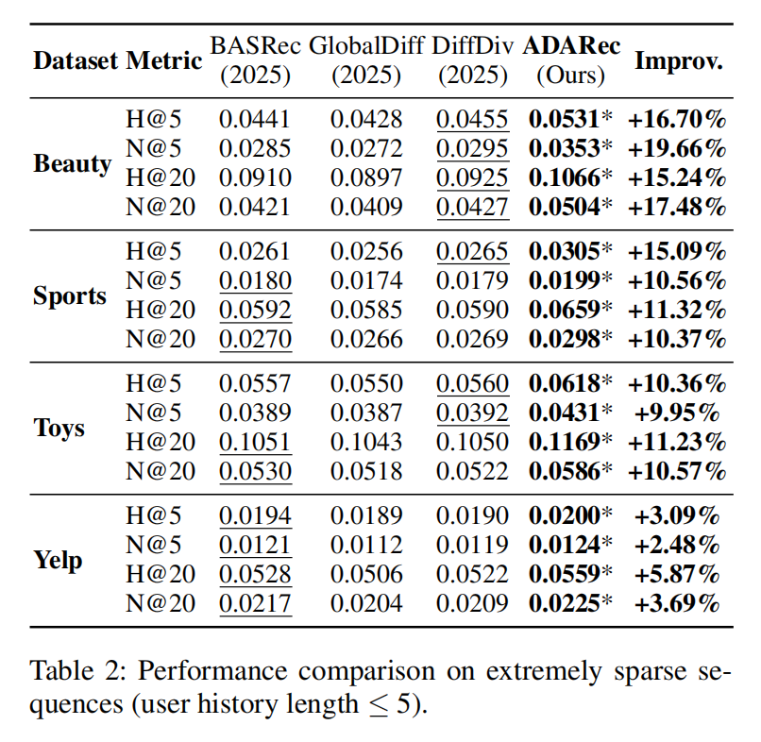
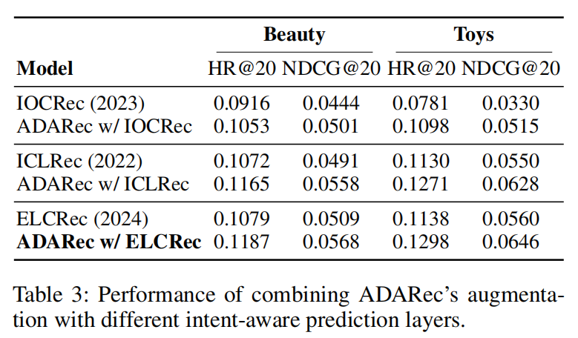
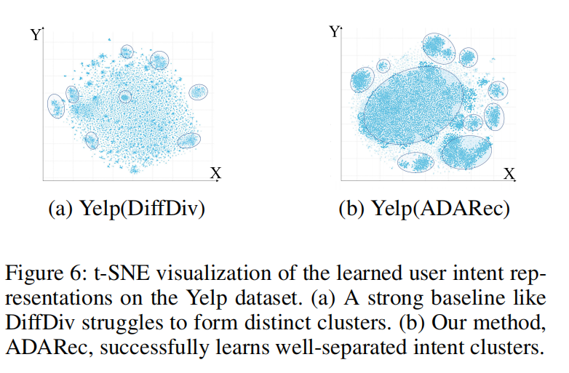
Experiments
ATAI
Advanced Technique of
Artificial Intelligence
ATAI
ChongqingUniversity _{AdvancedTechniqueof}
of Technology Artificial Intelligence
Chongqing University of Technology

Slide 9
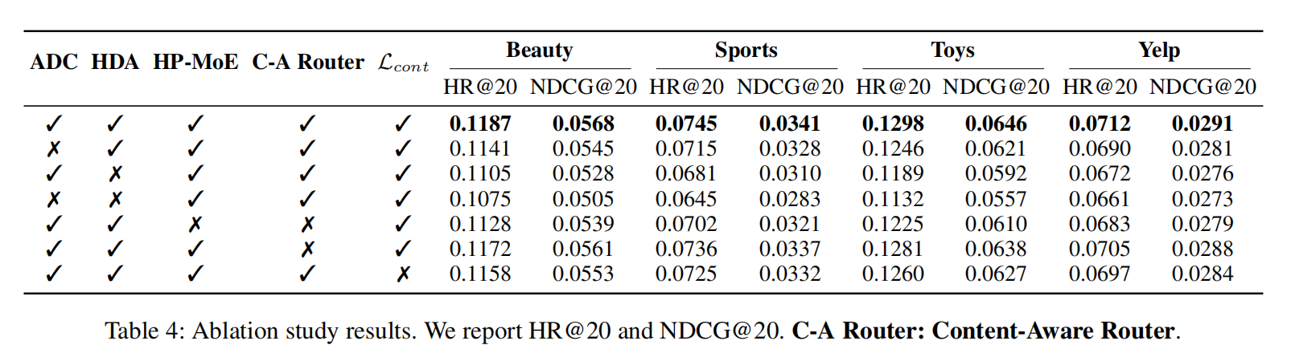
Experiments
ATAI
Advanced Technique of
Artificial Intelligence
ATAI
ChongqingUniversity _{AdvancedTechniqueof}
of Technology Artificial Intelligence
Chongqing University of Technology

Slide 10


ATAI
Advanced Technique of
Artificial Intelligence
ATAI
ChongqingUniversity _{AdvancedTechniqueof}
of Technology Artificial Intelligence
Chongqing University of Technology
Thanks!

